Slide 1
Intersection Safe
A intersection Collision Prevention System
Phase 4
By Team 11
Mohammed Al-Taie
Paul Westenberg
Erfan Reza
Saro Nokhoudian
Rifadul Haque
Jean Mardini
Notes:
Rifadul

Slide 2
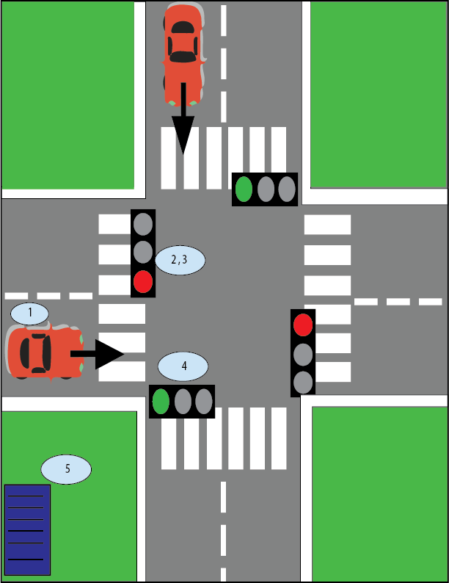
What is IntersectionSafe?
An intersection collision prevention system
Works by alerting perpendicular vehicles of an incoming speeding vehicle unable to stop before red/yellow light
Also acts as a data collection module, counting cars in order to obtain cars/hour measurement at intersection
This can be used to optimize traffic system
Notes:
Rifadul

Slide 3
Reaching Objectives - Phase 3
ID | Requirement | Pass/Fail
1 | Vehicle
1.1 | The vehicle(s) our system will detect will be standard passenger cars. The system will not detect buses, motorcycles, bicycles, ambulances or limousines. | Pass
1.2 | The cars our system will detect will be ± 20% of an average-car length (width of 1.76 m and height of 1.52 m), meaning it will detect between a width of 1.45 m and 2.12 m and between a height of 1.22 m and 1.83 m. | Pass
2 | Intersection
2.1 | The system shall detect vehicles at a + shaped 4-way intersection all containing traffic lights. Bike lanes will not be present at this intersection. | Pass
2.2 | The system shall detect vehicles at a 2 lane per road intersection. This means each side of the intersection will have 4 lanes, 2 going one way and 2 going the other. | Pass
2.3 | The lanes will be Quebec standard lane size measuring 3 metres. This means our system will be able to detect ± 20% of the lane, between 2.4 and 3.6 metres. | Pass
2.4 | The speed limit on all sides of the intersection will be 50 km/h. | Pass
Notes:
Rifadul

Slide 4
ID | Requirement | Pass/Fail/TBD
3 | Device
3.1 | The device shall be able to detect the speed of vehicles approaching the intersection within a range of 20 to 80 km/h | Pass
3.2 | The device shall aim at 34.7m¹ from the intersection in order to give the perpendicular vehicles 2 seconds to break in time | TBD
3.3 | The device shall detect the speed of the incoming vehicles with a maximum delay of 0.5 seconds². | TBD
4 | System
4.1 | The system shall be able to send the alert and display the alert with a maximum delay of 1 second³ upon reception of the speed. | TBD
4.2 | The system shall alert the perpendicular traffic using a bright light. The light specifications are stated below. | Pass
4.3 | The system shall record the information on the speed of the vehicles as well as the number of cars and send it to a server. There is no time constraint on this as it is not urgent. | Pass (still need server-side)
Notes:
Erfan

Slide 5
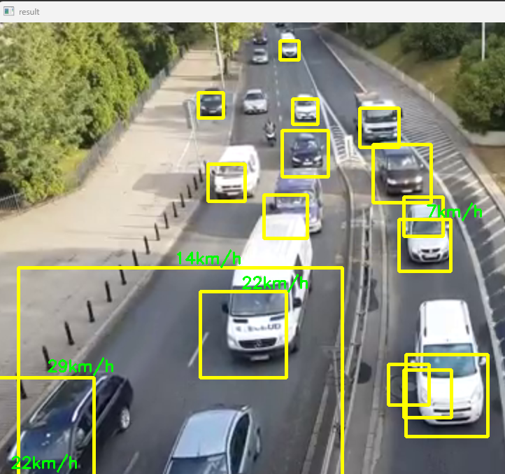
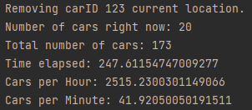
Design Implementation - Software
Python Script run on video ->
OpenCV library used to identify vehicles
Speed detected using difference in distance over time
Green for under 50km/h
Red for over 50km/h -> possible collision
Python Script also counts cars and time
Gives cars per minute in order to optimize traffic light system (see below)
Notes:
Erfan

Slide 6
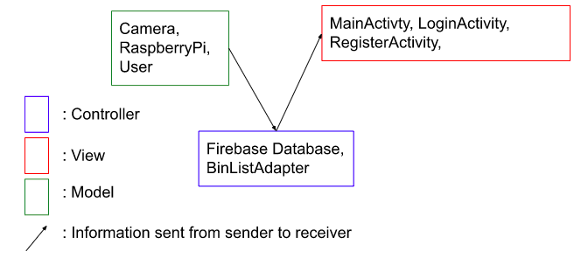
Design Implementation - Software RealTime Database
To send the information to firebase realtime database:
cred = credentials.Certificate("firebaseKey.json")
firebase_admin.initialize_app(cred, {
'databaseURL': 'https://intersection-safe-default-rtdb.firebaseio.com'
})
ref = db.reference('py/Intersection/VerticalTraffic')
Notes:
Medo
Communication
Firebase database picture
Android reception of information picture:

Slide 7
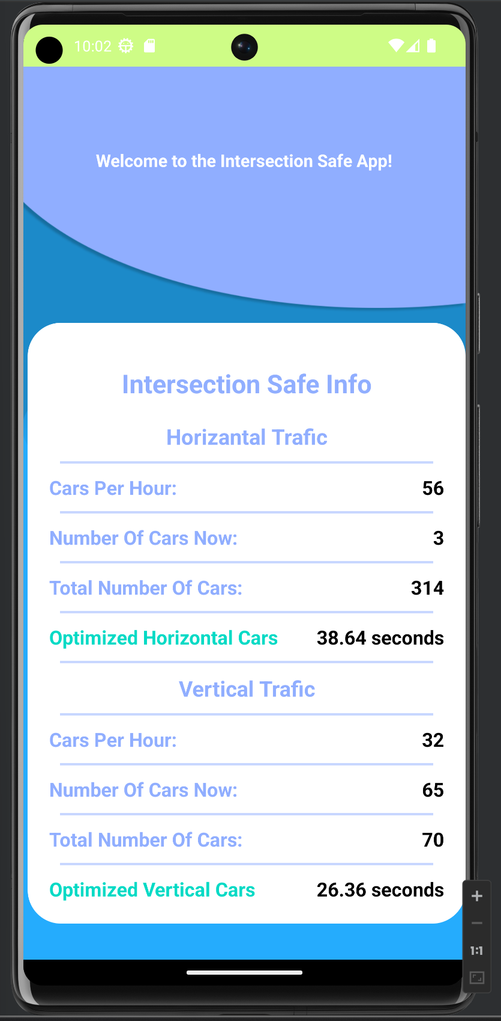
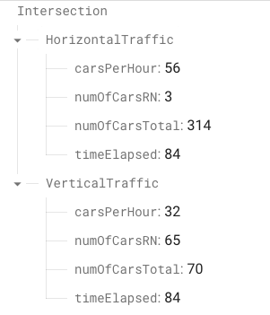


Design Implementation - Software App
Optimized horizontal traffic =
15 + 45*(HorizontalcarsPerHour/(HorizontalcarsPerHour+VerticalCarsPerHour))
Notes:
Medo

Slide 8
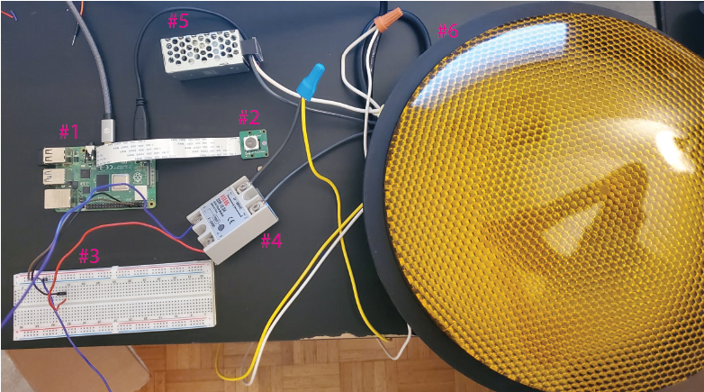
Design Implementation - Hardware Components
Components
Raspberry Pi
Arducam
Breadboard
Relay
AC to DC Power Supply
LED
Wires:
Power cable connected to push in terminals
From terminal to power supply and relay
From power supply generate 5V 3A 15W to raspberry pi.
From raspberry pi to relay and camera
Relay to light
Notes:
Saro

Slide 9
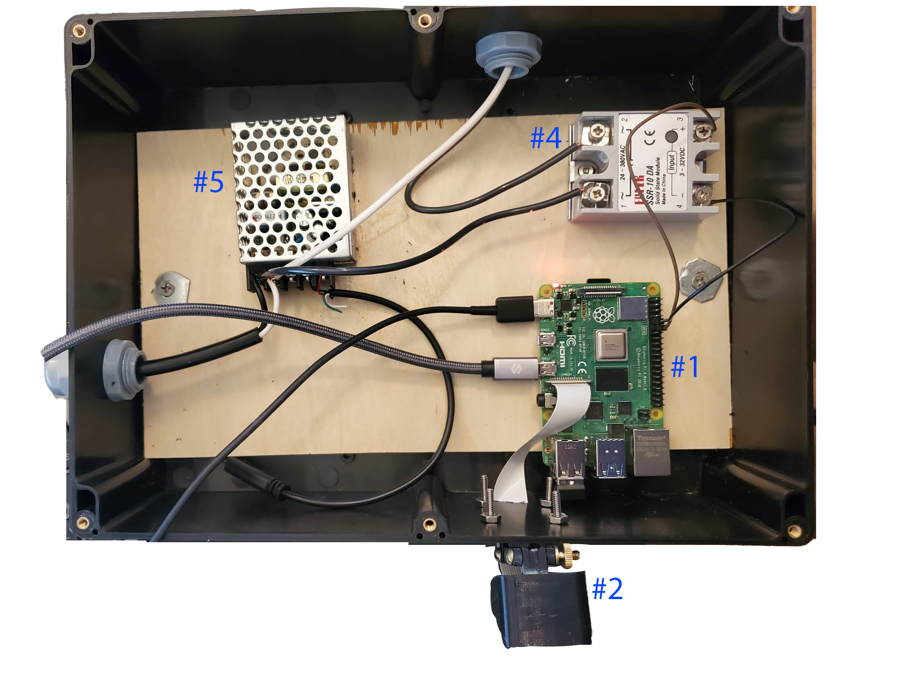
Design Implementation - Hardware Cover
Notes:
Saro

Slide 10
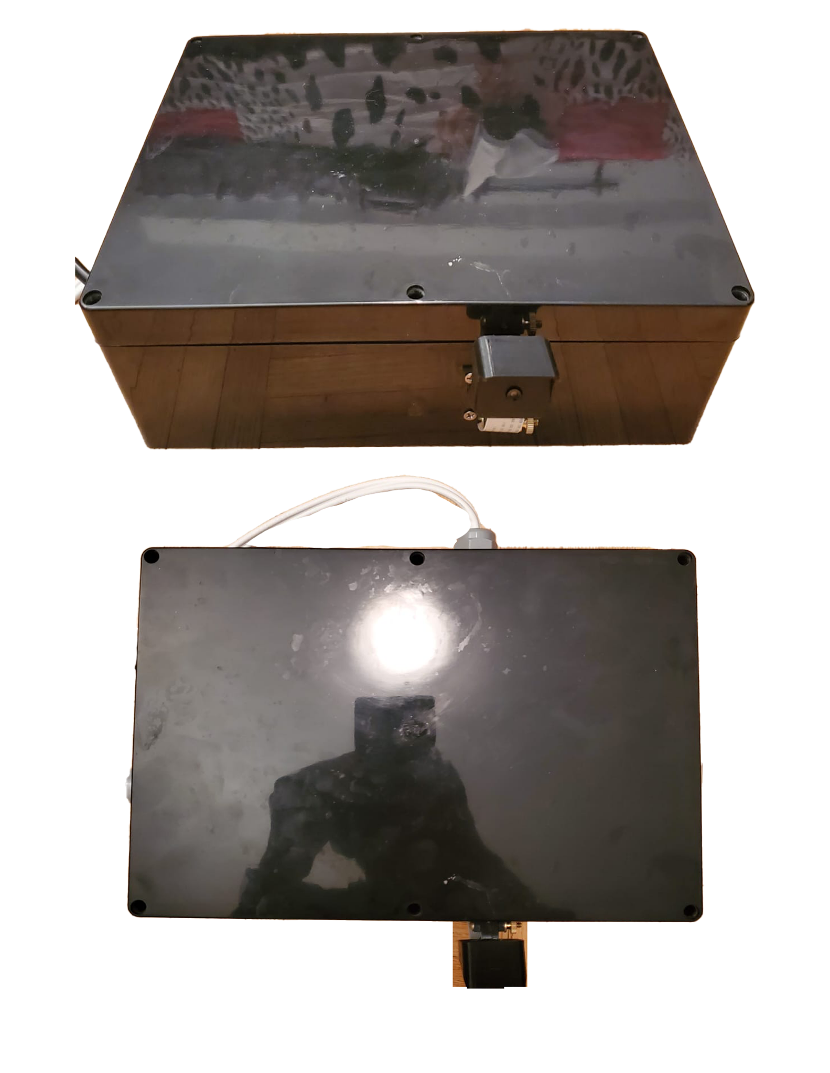
Design Implementation - Hardware Cover

Slide 11

Tests Performed: (1) control case, (2) normal case, and (3) extreme case

Slide 12
Tests Performed - Results on 20 tests:
10 above limit and 10 under
Real Situation -> Test | Car above 40 km/h | Car under 40 km/h
Alarm went on | 8 | 0
Alarm didn’t go on | 2 | 10
8 True Positives
0 False Positives -> very good
2 False Negatives -> ok since this is what it would be like with no device
8 True Negatives
Notes:
Erfan

Slide 13
Reaching Objectives - Final Design
ID | Requirement | Pass/Fail
1 | Vehicle
1.1 | The vehicle(s) our system will detect will be standard passenger cars. The system will not detect buses, motorcycles, bicycles, ambulances or limousines. | Pass
1.2 | The cars our system will detect will be ± 20% of an average-car length (width of 1.76 m and height of 1.52 m), meaning it will detect between a width of 1.45 m and 2.12 m and between a height of 1.22 m and 1.83 m. | Pass
2 | Intersection
2.1 | The system shall detect vehicles at a + shaped 4-way intersection all containing traffic lights. Bike lanes will not be present at this intersection. | Pass
2.2 | The system shall detect vehicles at a 2 lane per road intersection. This means each side of the intersection will have 4 lanes, 2 going one way and 2 going the other. | Pass
2.3 | The lanes will be Quebec standard lane size measuring 3 metres. This means our system will be able to detect ± 20% of the lane, between 2.4 and 3.6 metres. | Pass
2.4 | The speed limit on all sides of the intersection will be 50 km/h. | Pass
Notes:
Paul

Slide 14
ID | Requirement | Pass/Fail/TBD
3 | Device
3.1 | The device shall be able to detect the speed of vehicles approaching the intersection within a range of 20 to 80 km/h | Pass
3.2 | The device shall aim at 34.7m¹ from the intersection in order to give the perpendicular vehicles 2 seconds to break in time | Pass
3.3 | The device shall detect the speed of the incoming vehicles with a maximum delay of 0.5 seconds². | Pass
4 | System
4.1 | The system shall be able to send the alert and display the alert with a maximum delay of 1 second³ upon reception of the speed. | Pass
4.2 | The system shall alert the perpendicular traffic using a bright light. The light specifications are stated below. | Pass
4.3 | The system shall record the information on the speed of the vehicles as well as the number of cars and send it to a server. There is no time constraint on this as it is not urgent. | Pass
Notes:
Paul

Slide 15
Thank you!
We’d like to thank all of you for your great judgement, kind and patient attitude and knowledge
Notes:
Paul

